Slide 1

Open-source Brain-Computer interface
KHOA CÔNG NGHỆ PHẦN MỀM
OPENBCI
HCM-2023

Slide 2
NỘI DUNG
Giới thiệu
Cyton
3D Brain Visualizer

Slide 3


Slide 4
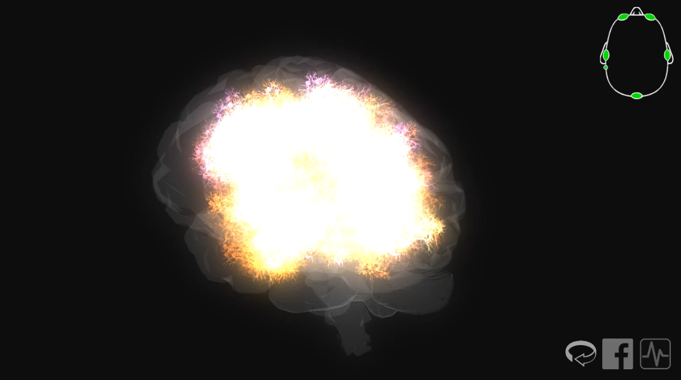
3D Brain Visualizer

Slide 5
EEG Electrode Cap Kit

Slide 6
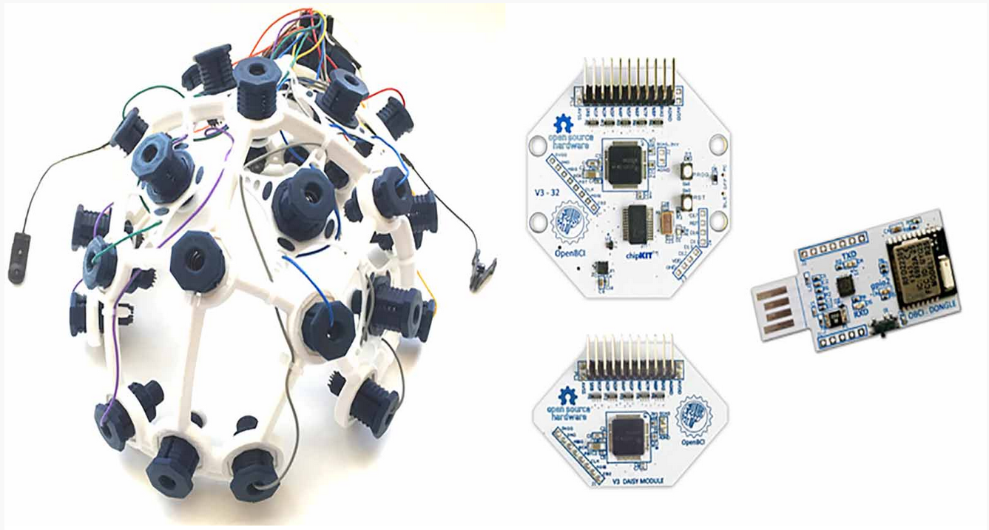
OpenBCI developed a customizable and affordable headset

Slide 7
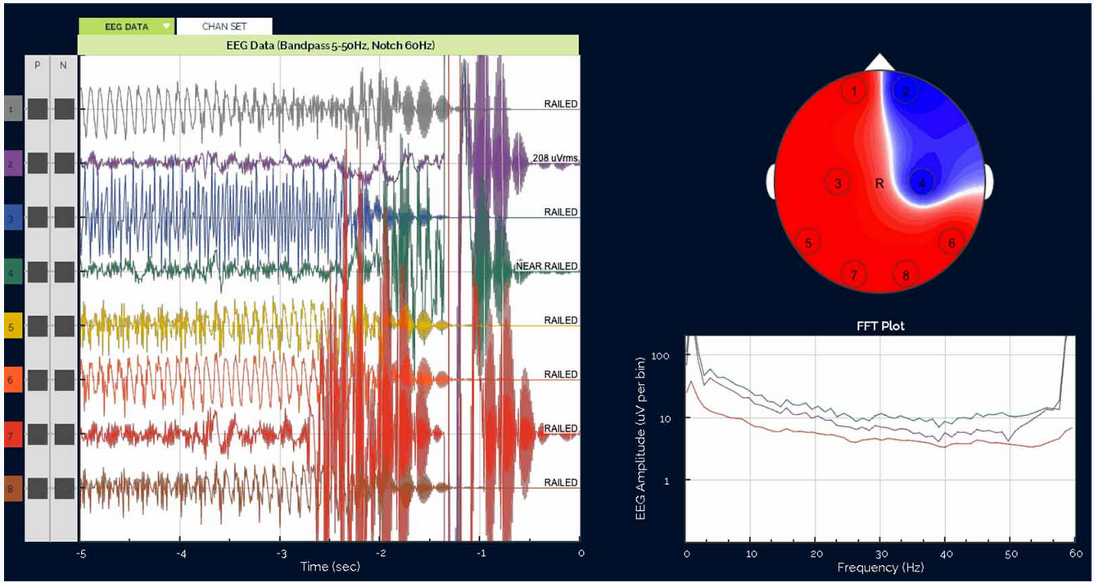
OpenBCI community has developed a number of open source EEG acquisition and post-processing tools

Slide 8
Cyton Biosensing Board (8-channels)

Slide 9
Cyton Board Specs:
Power with 3-6V DC Battery ONLY
PIC32MX250F128B Microcontroller with chipKIT UDB32-MX2-DIP bootloader
ADS1299 Analog Front End
LIS3DH 3 axis Accelerometer
RFduino BLE radio
Micro SD card slot
Voltage Regulation (3.3V, +2.5V, -2.5V)
Board Dimensions 2.41" x 2.41" (octogon has 1" edges)
Mount holes are 1/16" ID, 0.8" x 2.166" on center
Input voltage range: +2.5 to -2.5V
Signal-Noise-Ratio: 121 dB
Voltage resolution = 0.298 microvolt/bit (5V/16777216). Resolution = Voltage level / 2^n where n is the bit-level of ADC

Slide 10
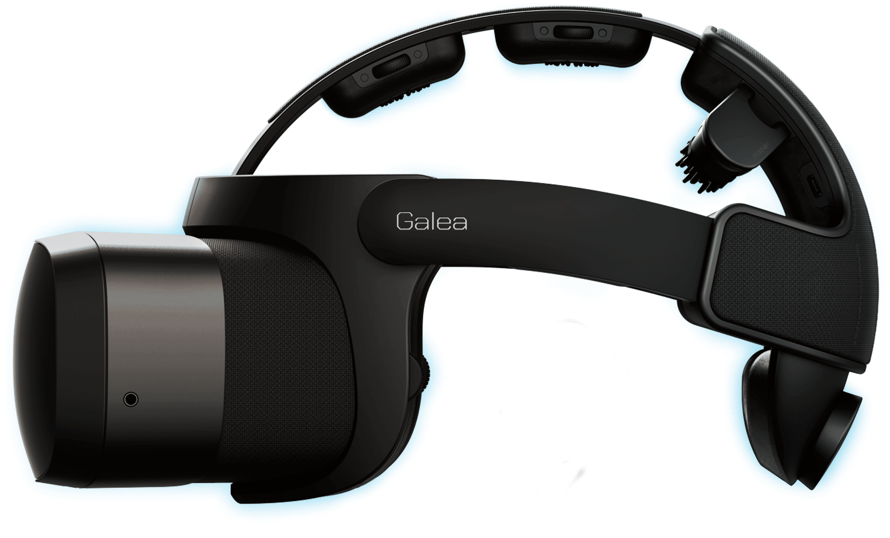

Slide 11
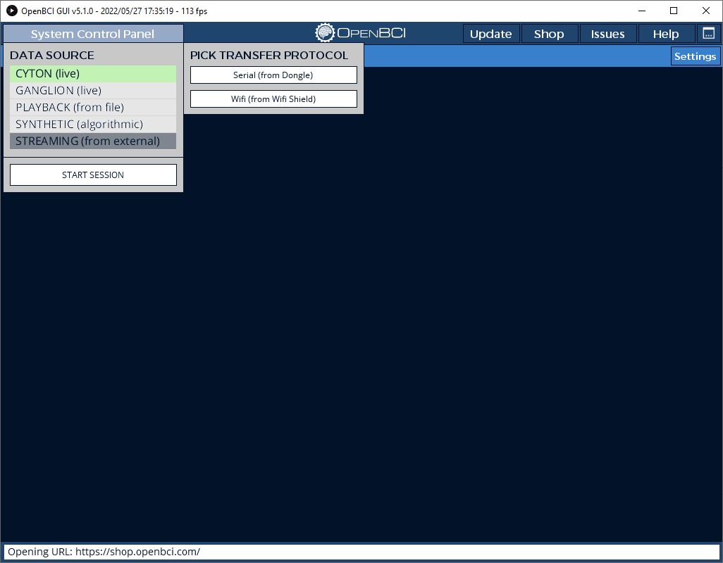

Slide 12
